Slide 1

Renting Stuffs Application

Slide 2


Lockdowns!!

Slide 3


Slide 4
Online

Slide 5

Education

Slide 6

Shopping

Slide 7


Slide 8


Socializing

Slide 9

All of us have to buy some stuffs to use it once or just for few times!

Slide 10
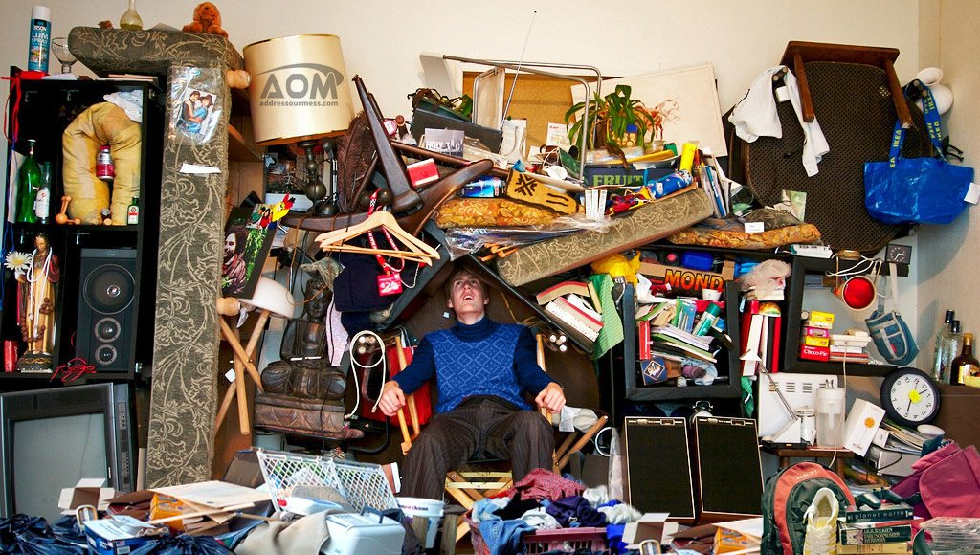

Slide 11
Overstock

Slide 12
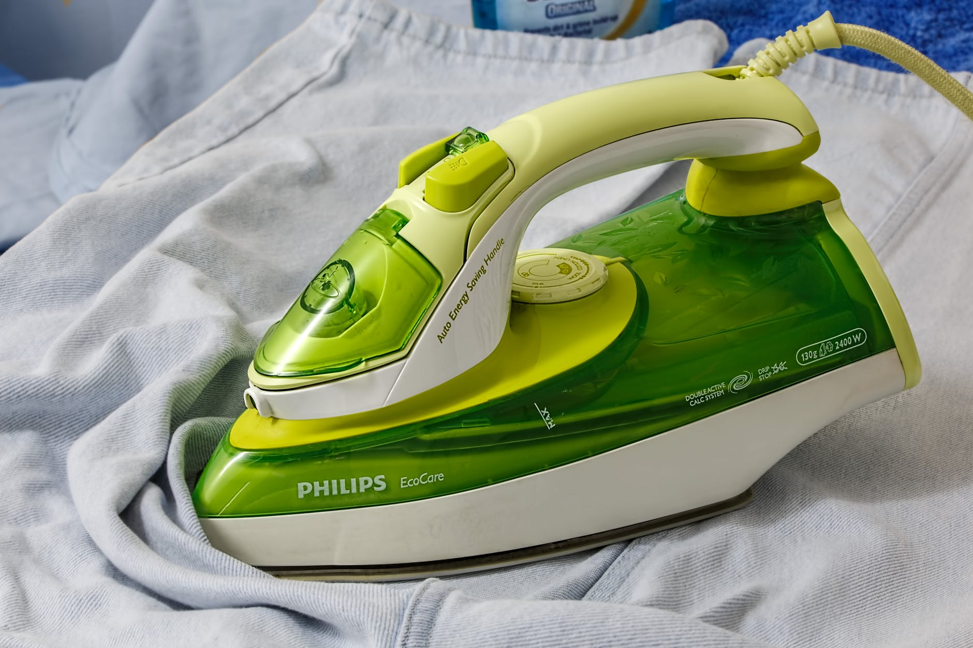
Background and motivation
Travelers
When you travel you need some stuffs
Students
Especially abroad students who lives in accommodations
Lack of applications
Only for cars and houses
Time
Or even Your Time
Money
Why to waste your money!
Iron
There is a story behind that

Slide 13



Slide 14

Aims and Objectives
I
Facilitate people’s lives.
II
Save MONEY and TIME
III
Sharing
IV
Make Money from unused Stuffs
V
Connect Renters And Owners

Slide 15

Existing systems
Huge systems didn’t Start From Zero

Slide 16
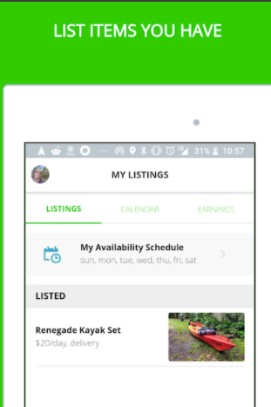
Existing systems
IDOL

Slide 17
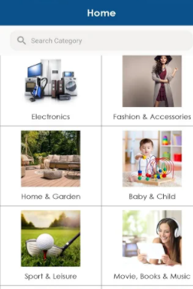
Existing systems
RentYourStuffs

Slide 18

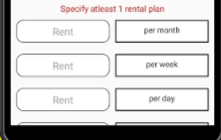
Existing systems
All4RENTZ

Slide 19
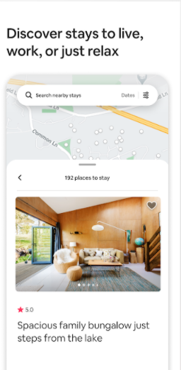
Existing systems
AirBnb

Slide 20
Existing systems
Easy, Simple And Smart.

Slide 21

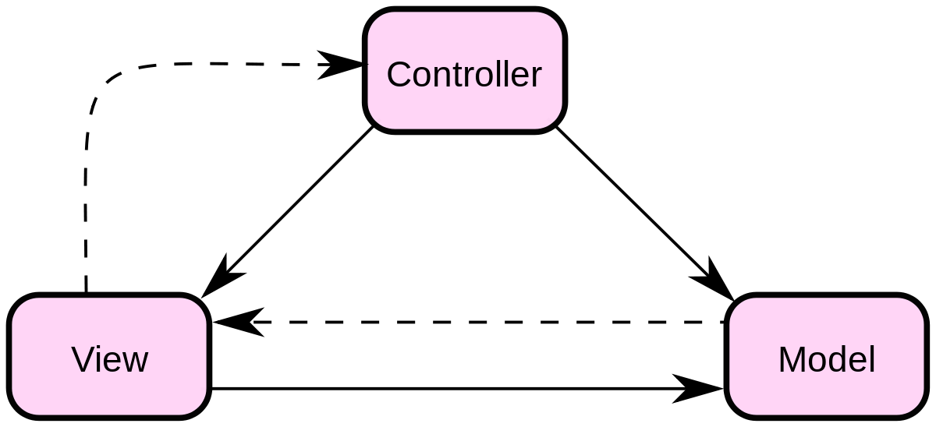
System Architecture

Slide 22
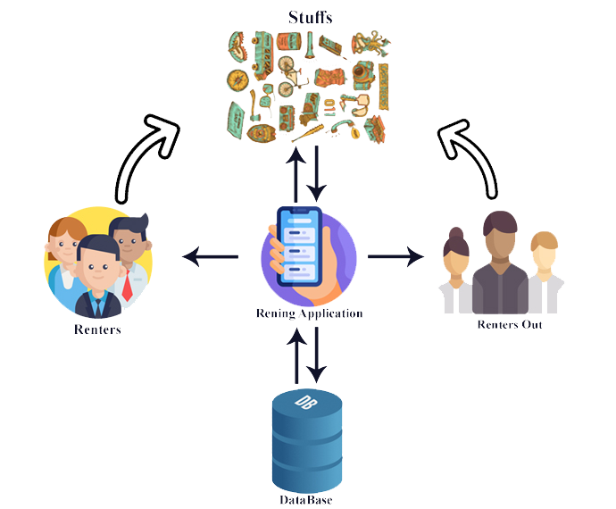
System Architecture

Slide 23
How does it work ?

Slide 24
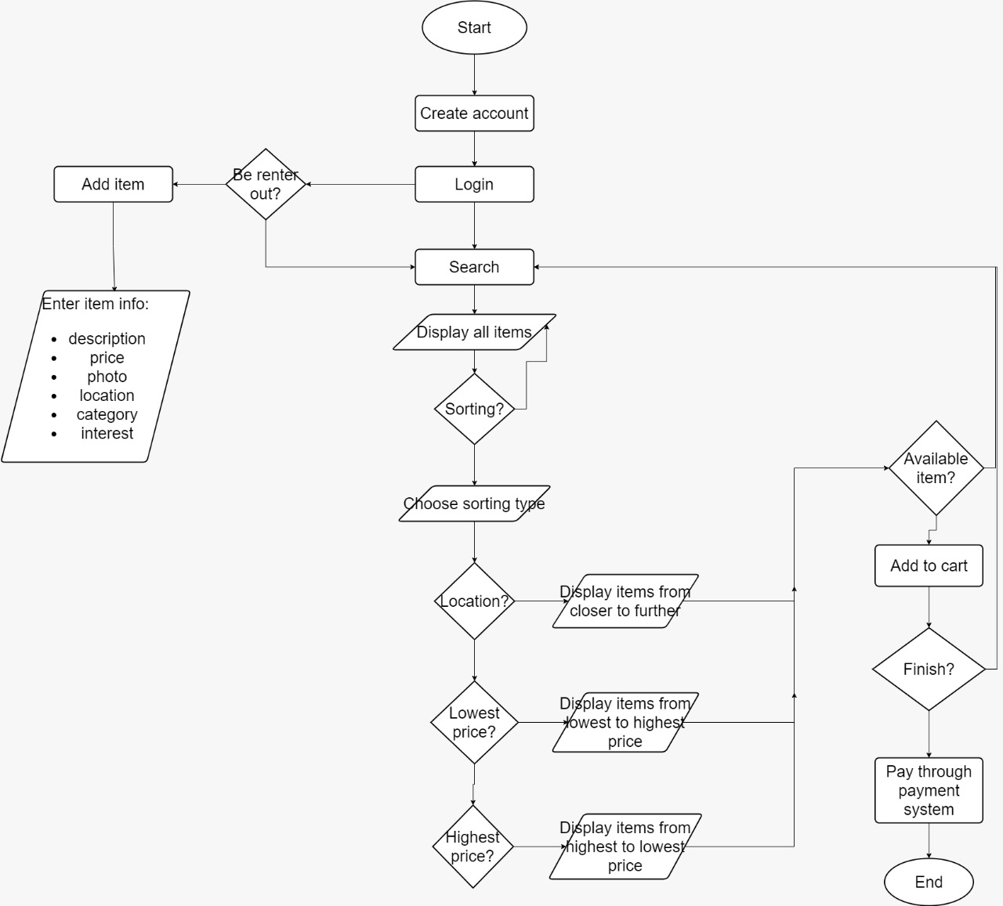

Slide 25

What About the Algothims ?

Slide 26
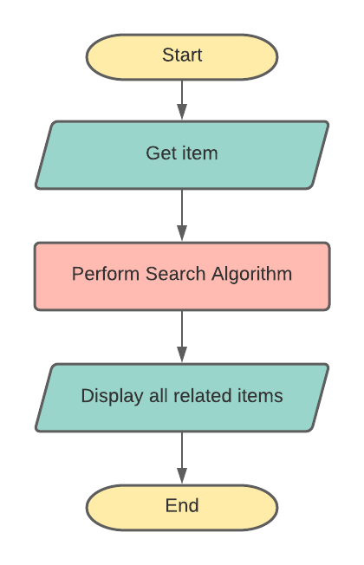
Search Algorithm Design

Slide 27
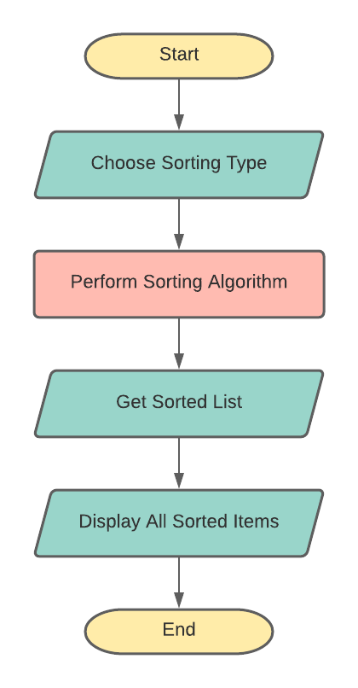
Sorting Algorithm Design

Slide 28

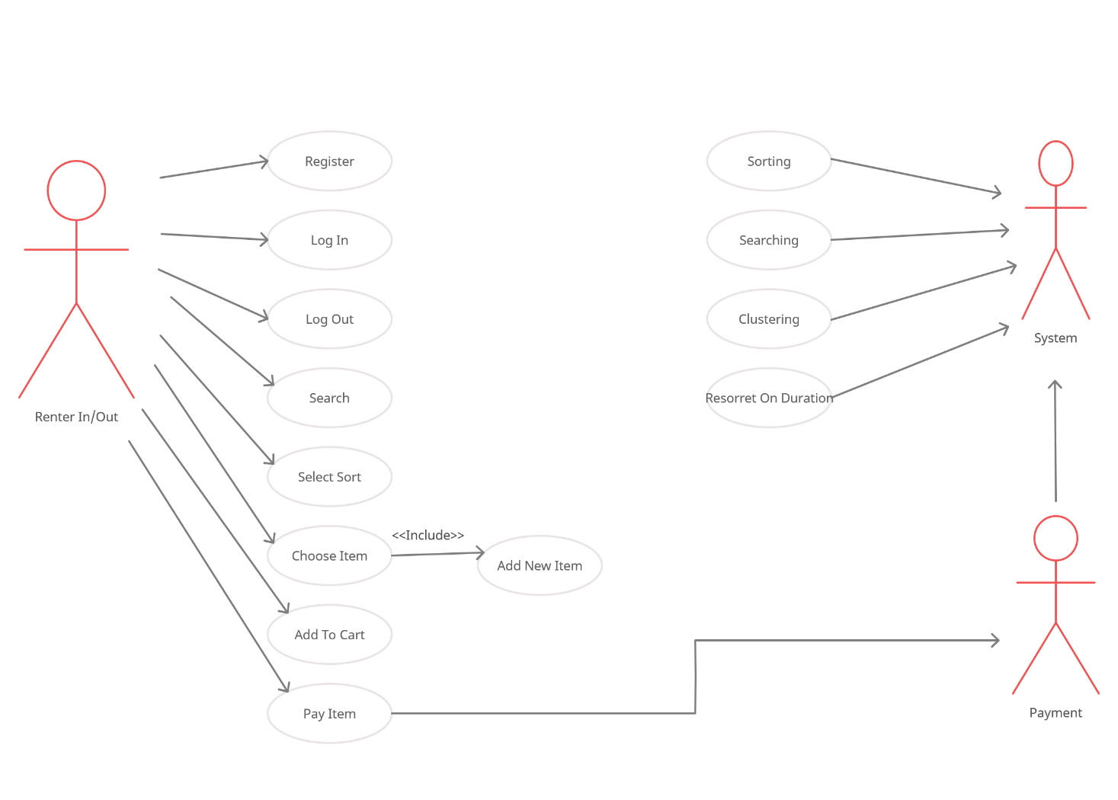
Usecase Diagram

Slide 29
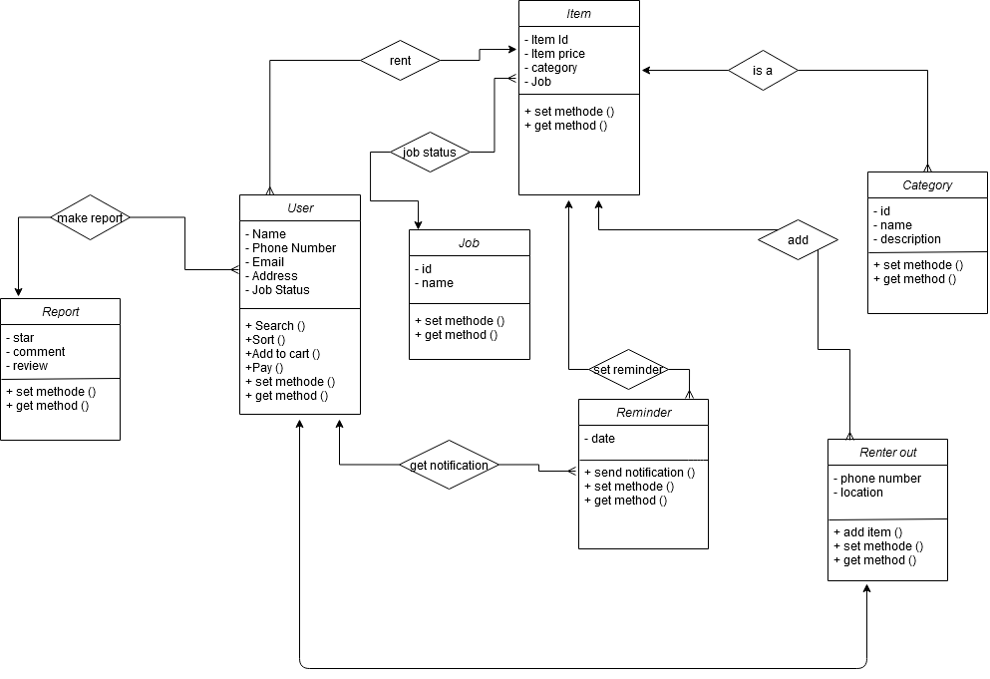
Class Diagram

Slide 30
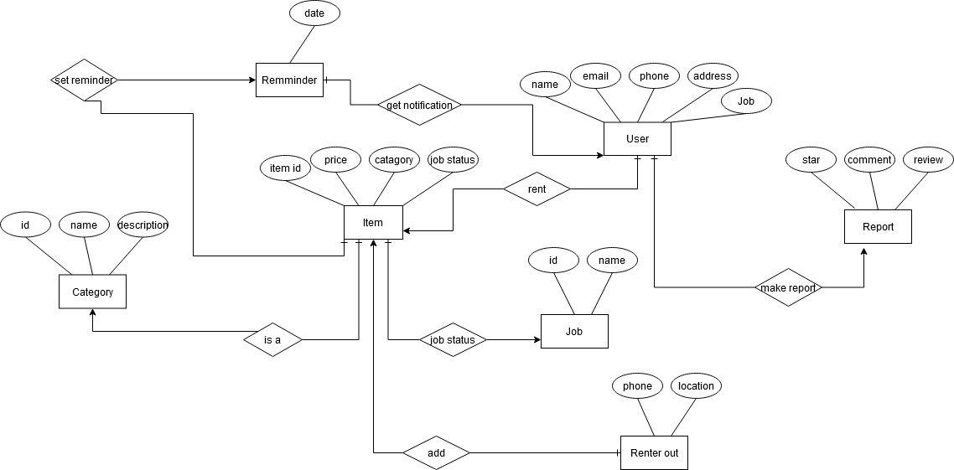
ER Diagram

Slide 31

Makes Money from unused stuffs
save Money and TIME
So, No matter from where or when are you renting!
Awareness about sharing culture
Easier life

Slide 32

Future plan

Slide 33


